Slide 1
North Dallas Chamber Commerce (NDCC) Energy Forum
Pablo Vegas
ERCOT President & CEO
January 26, 2024

Slide 2
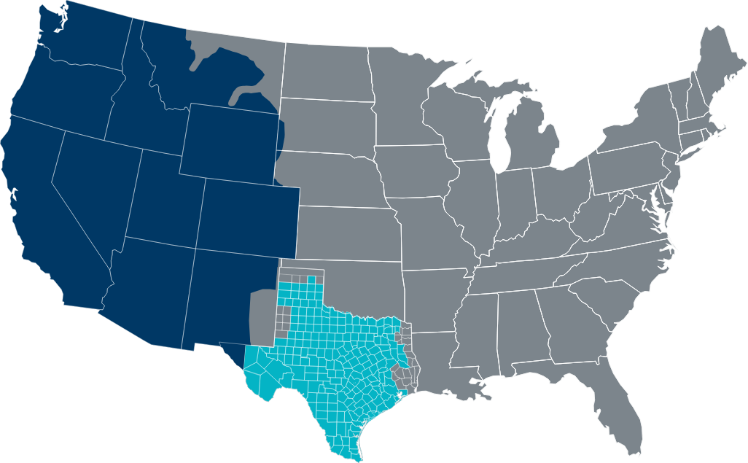
The ERCOT Region
The interconnected electrical system serving most of Texas, with limited external connections
90% of Texas electric load; 75% of Texas land
85,508 MW peak, Aug. 10, 2023
More than 52,700 miles of transmission lines
1,100+ generation units (including PUNs)
ERCOT connections to other grids are limited to ~1,220 MW of direct current (DC) ties, which allow control overflow of electricity

Slide 3
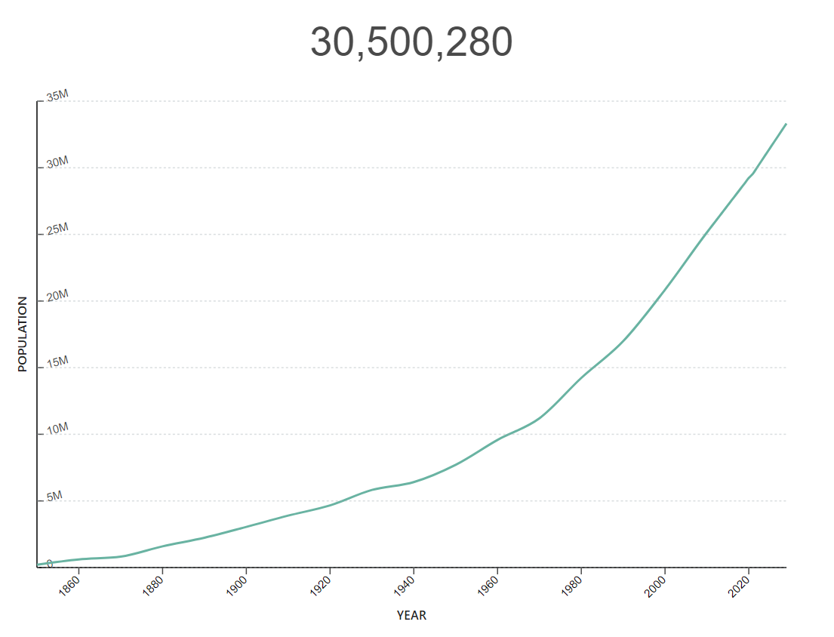
Texas’ Estimated Population Growth
Texas Population 2023
30,500,280*
Estimated Growth
2024: 31 million
2025: 31.4 million
2026: 31.9 million
2027: 32.4 million
2028: 32.9 million
*The last US census was in 2020, so current figures are projected based on the estimates only.
Notes:
Sources: TEXAS: 2020 Census
Texas Population 2023 (Demographics, Maps, Graphs) (worldpopulationreview.com)
Texas Demographic Center
US Census State Population Estimates
US Census County Population Estimates
American Community Survey (2009 - 2013)
Census QuickFacts

Slide 4
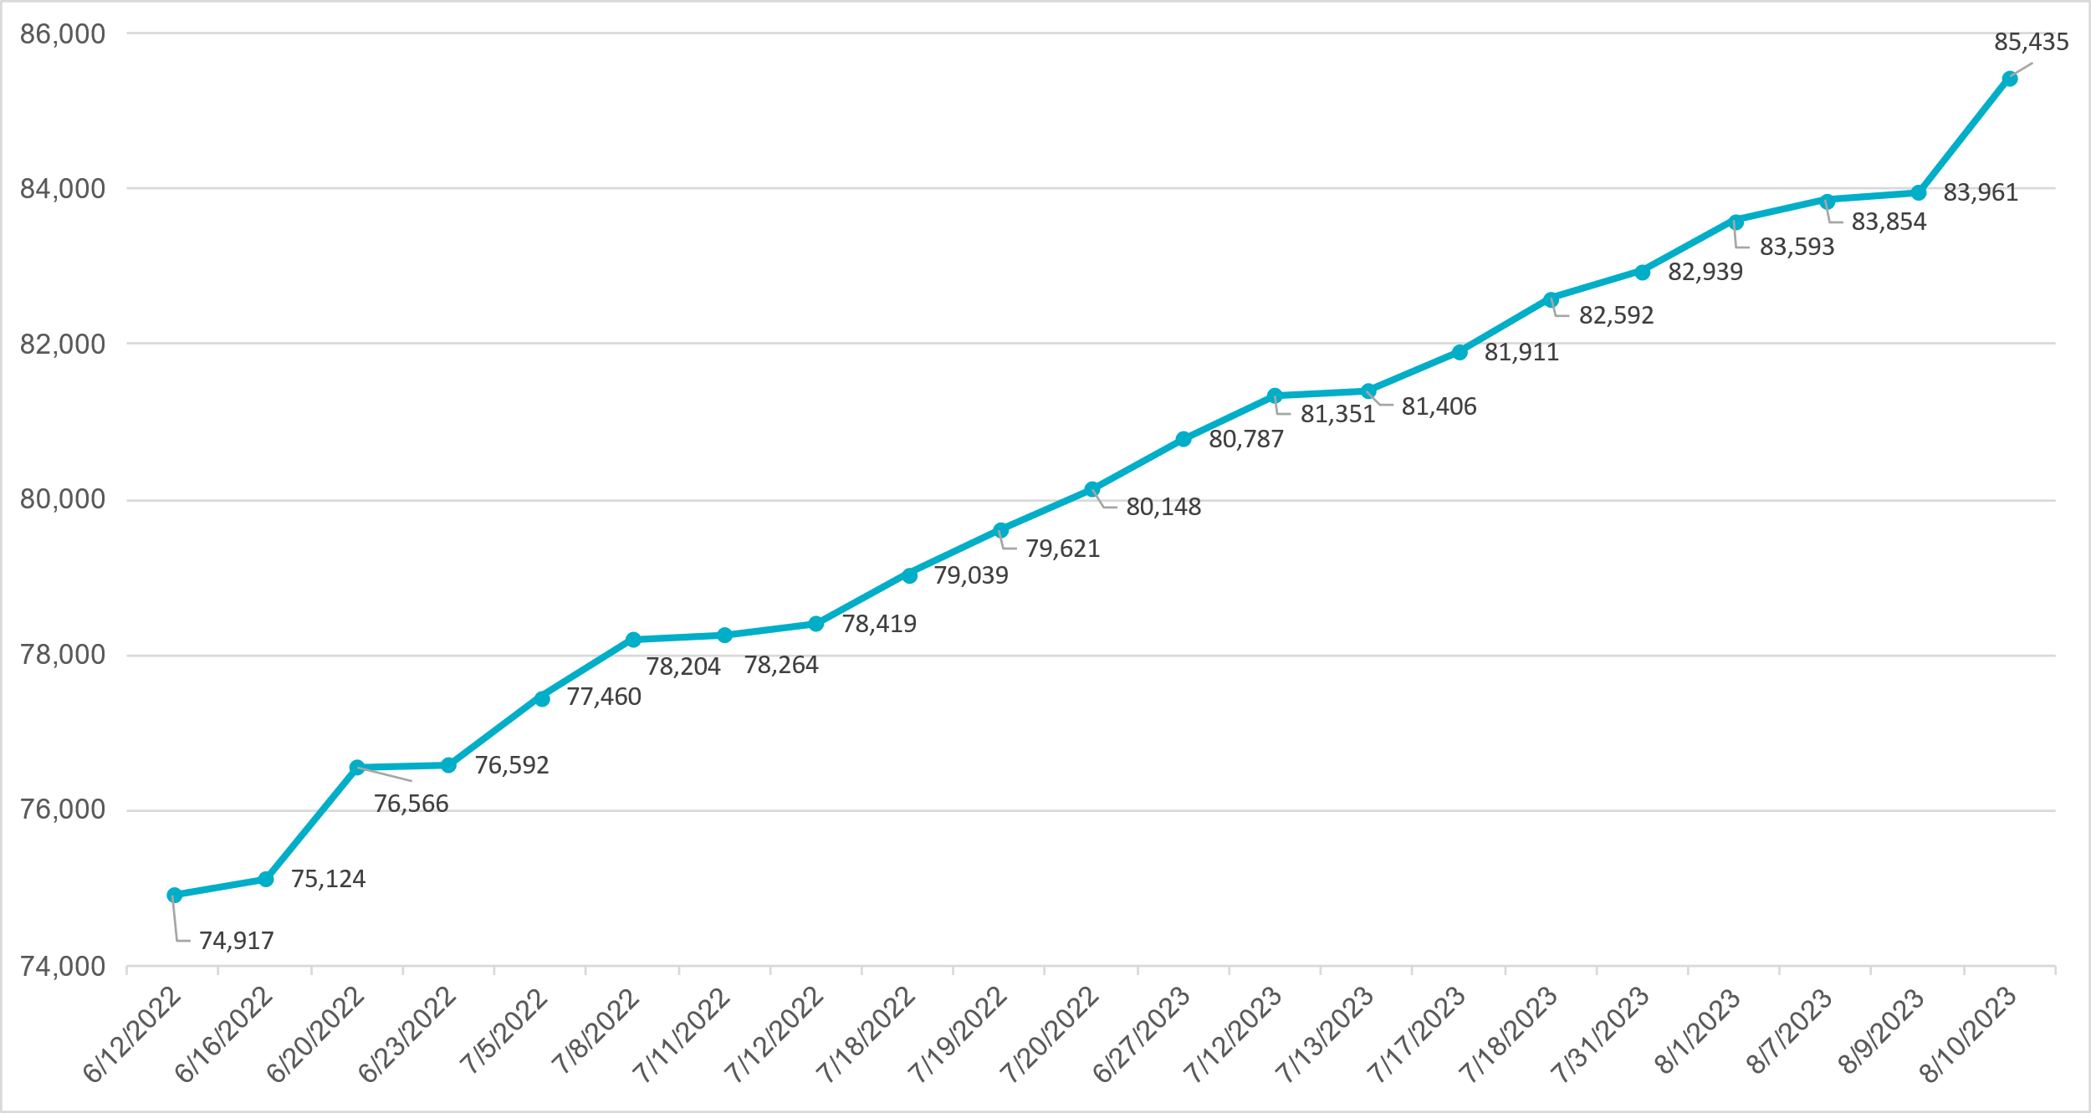
2022-2023 Summer Peak Demand Records
85,508
2022
2023
Days Over 80 GW Peak
Month | 2021 | 2022 | 2023
June | 0 | 0 | 4
July | 0 | 1 | 15
August | 0 | 0 | 26
September* | 0 | 0 | 4
Key Takeaway: Peak demand for summer increased drastically over the last two years. Summer 2023 had 49 days with a peak higher than 80 GW (the previous all-time peak demand).

Slide 5
The ERCOT Electric Grid: Capacity and Demand
2000 Generating Capacity
2024 Generating Capacity
*Includes biomass-fired units and DC Tie capacity
*Includes biomass-fired units and DC Tie capacity
2000
All-Time Peak Demand Record
As of January 2024
All-Time Peak Demand Record
57,606 MW
85,508 MW
48% increase
^{(August 10, 2023)}
Notes:
2000 data: reflects the forecasted operational installed capacity, based end of year 2000 data from ERCOT Installed Capacity Mix Trends
2024 data: reflects operational installed capacity based on December CDR report for Summer 2024.
Peak demand: 48% increase from the 2000 peak demand of 57,606 MW to 85,508 on August 10, 2023

Slide 6
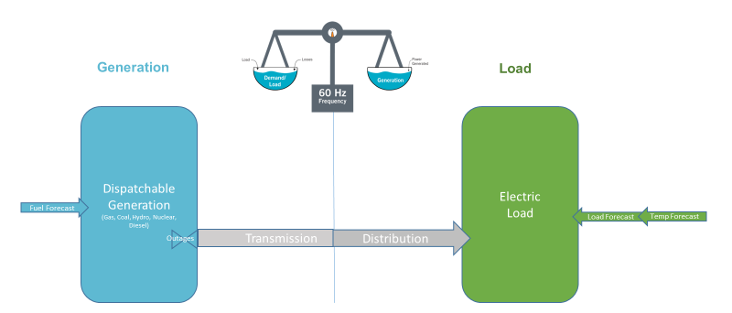
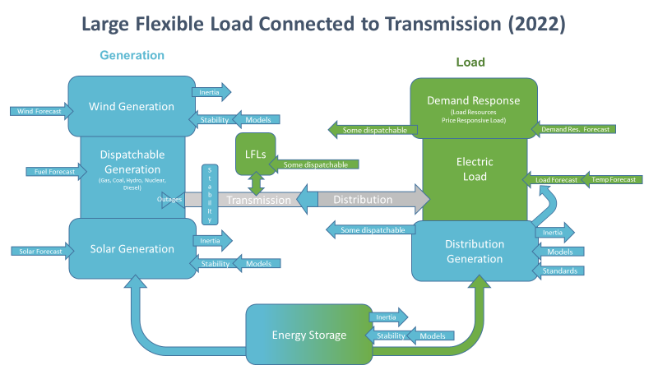
The ERCOT Electric Grid: Then and Now
Notes:
Where we have been

Slide 7
Weatherization
ERCOT conducts weatherization inspections of generating and transmission facilities. Weatherization inspections are tracking well ahead of the required rate of 1800 inspections over 3 years to meet 2024 goal.
Total as of December 2023
1774 weatherization inspections
(1264 generation resources and 510 Transmission Service Providers (TSP) facilities)

Slide 8
Transmission Planning Summary
As of October 12, 2023, projects energized in 2023 total about $1.533 billion.
$1.567 billion energized in all of 2022
As of December 31, 2023, ERCOT has endorsed transmission projects totaling $3.231 billion.
Total endorsed transmission projects in 2022 equaled $3.311 billion
As of October 12, 2023, projects in engineering, routing, licensing, and construction total about $13.537 billion
Notes:
Data from RMC December 18, 2023, presentation

Slide 9
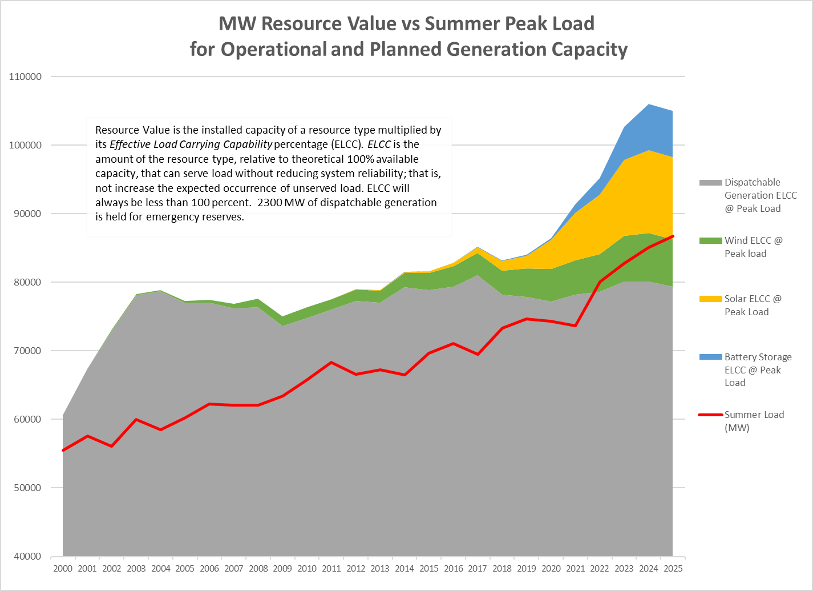
Illustration of Long-Term Resource Adequacy Issue (Summer)
Dispatchable Thermal Generation
(2000-2008) more than 20,000 MW of net new dispatchable thermal generation added to the grid.
(2008-2022) only 1,500 MW of net new dispatchable thermal generation added.
20,925 MW retired
22,485 MW added
More than 48,000 MW of net new solar and wind added (2008-2022).
Total Thermal Fleet is 77,040 MW
41% is older than 30 years (31,863 MW) (1993)
27% is older than 40 years (21,148 MW) (1983)
12% is older than 50 years (9,586 MW) (1973)
2% is older than 60 years (1,737 MW) (1963)
MW Resource Value vs Summer Peak Load for Operational and Planned Generation Capacity
Dispatchable Thermal Generation
ELCC
@ Peak Load
Wind ELCC
@ Peak Load
Solar ELCC
@ Peak Load
Battery Storage
@ Peak Load
Summer
Load (MW)
(Note: Resource Value is the installed capacity of a resource type multiplied by its Effective Load Carrying Capability (ELCC), ELCC is the amount of the resource type relative to theoretical 100% available capacity, that can serve load without reducing system reliability; that is, not increase the expected occurrence of unserved load. ELCC will always be less than 100 percent. (2300 MW of dispatchable generation is held for emergency reserves).
9

Slide 10
Generation Interconnection Requests
1,671 active generation interconnection requests totaling 325,215 MW as of December 23, 2023.
Solar: 145,654 MW
Wind: 34,591 MW
Gas: 15,483 MW
Battery: 127,068 MW
A break-out by zone can be found in the monthly Generator Interconnection Status (GIS) reports available on the Resource Adequacy Page: http://www.ercot.com/gridinfo/resource
*Other includes petroleum coke (pet coke), hydroelectric, fuel oil, geothermal energy, other miscellaneous fuels reported by developers, and fuel cells that use
fuels other than natural gas.
Notes:
As of December 23, 2023

Slide 11
Nuclear Dispatchable Generation
August 16, 2023: Gov. Abbott letter directed the PUCT to establish working group to study and plan for nuclear reactors in Texas, to:
Understand states’ role in deploying advanced nuclear reactors for grid reliability
Determine nuclear-specific changes in ERCOT market; regulatory impediments to development; permitting for building reactors.
Coordinate with stakeholders on timely implementation of reactors.
Identify any federal incentives for Texas and stakeholders.
Working group will coordinate with ERCOT to solve technical challenges of incorporating nuclear energy into the ERCOT grid.
September 28, 2023: Texas Advanced Nuclear Reactor Working Group: Commissioner Jimmy Glotfelty convened first public working group
Proposed organizational structure and work plan necessary to carry out Gov. Abbott’s directive to plan for the use of advanced nuclear reactors in Texas.
December 1, 2024: Working Group to submit plan and recommendations to Gov. Abbott on how Texas will be come the national leader in using advanced nuclear technology.
Notes:
Reference: https://gov.texas.gov/uploads/files/press/Jackson,_Kathleen_08.16.23.pdf
TX Advanced Nuclear Reactor Working Group Sept 28 workshop.pdf

